Slide 1



Slide 2

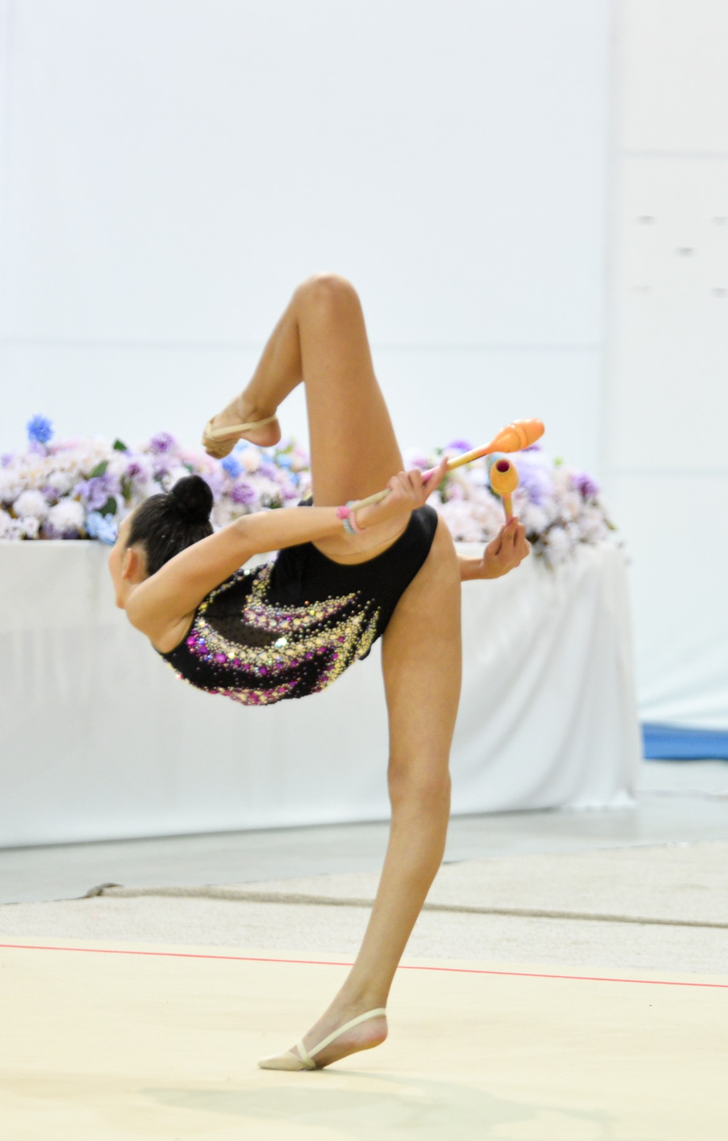
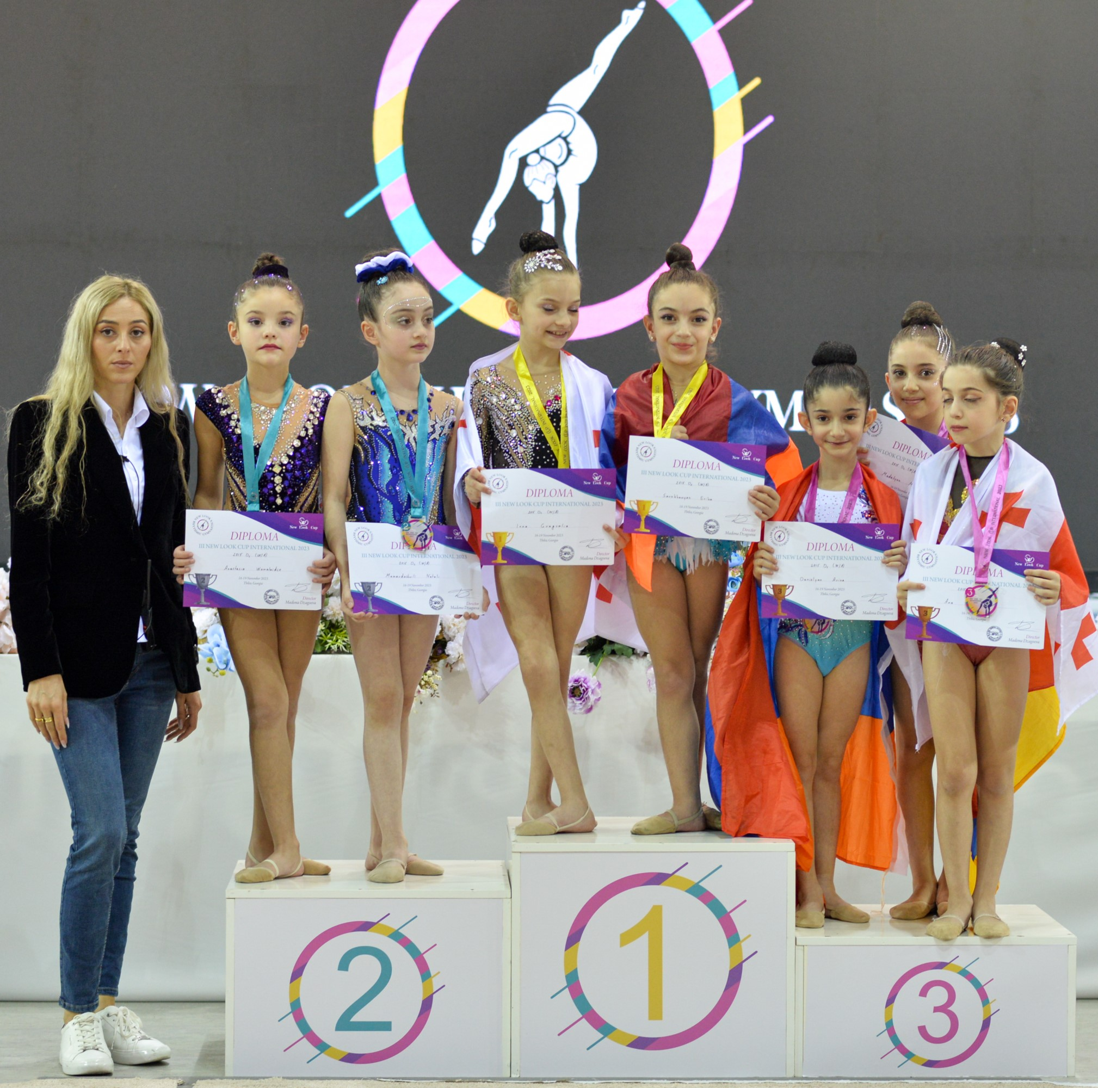
I X International Tournament in
Rhythmic Gymnastics
New Look Cup International 2024
November 1-3, 2024,
Tbilisi, Georgia
Super prize iPhone 15 for Miss New Look Cup 2024
newlookcup@gmail.com
+995571247171
Instagram/Facebook: New_Look_Rhythmic_Gymnastics

Slide 3
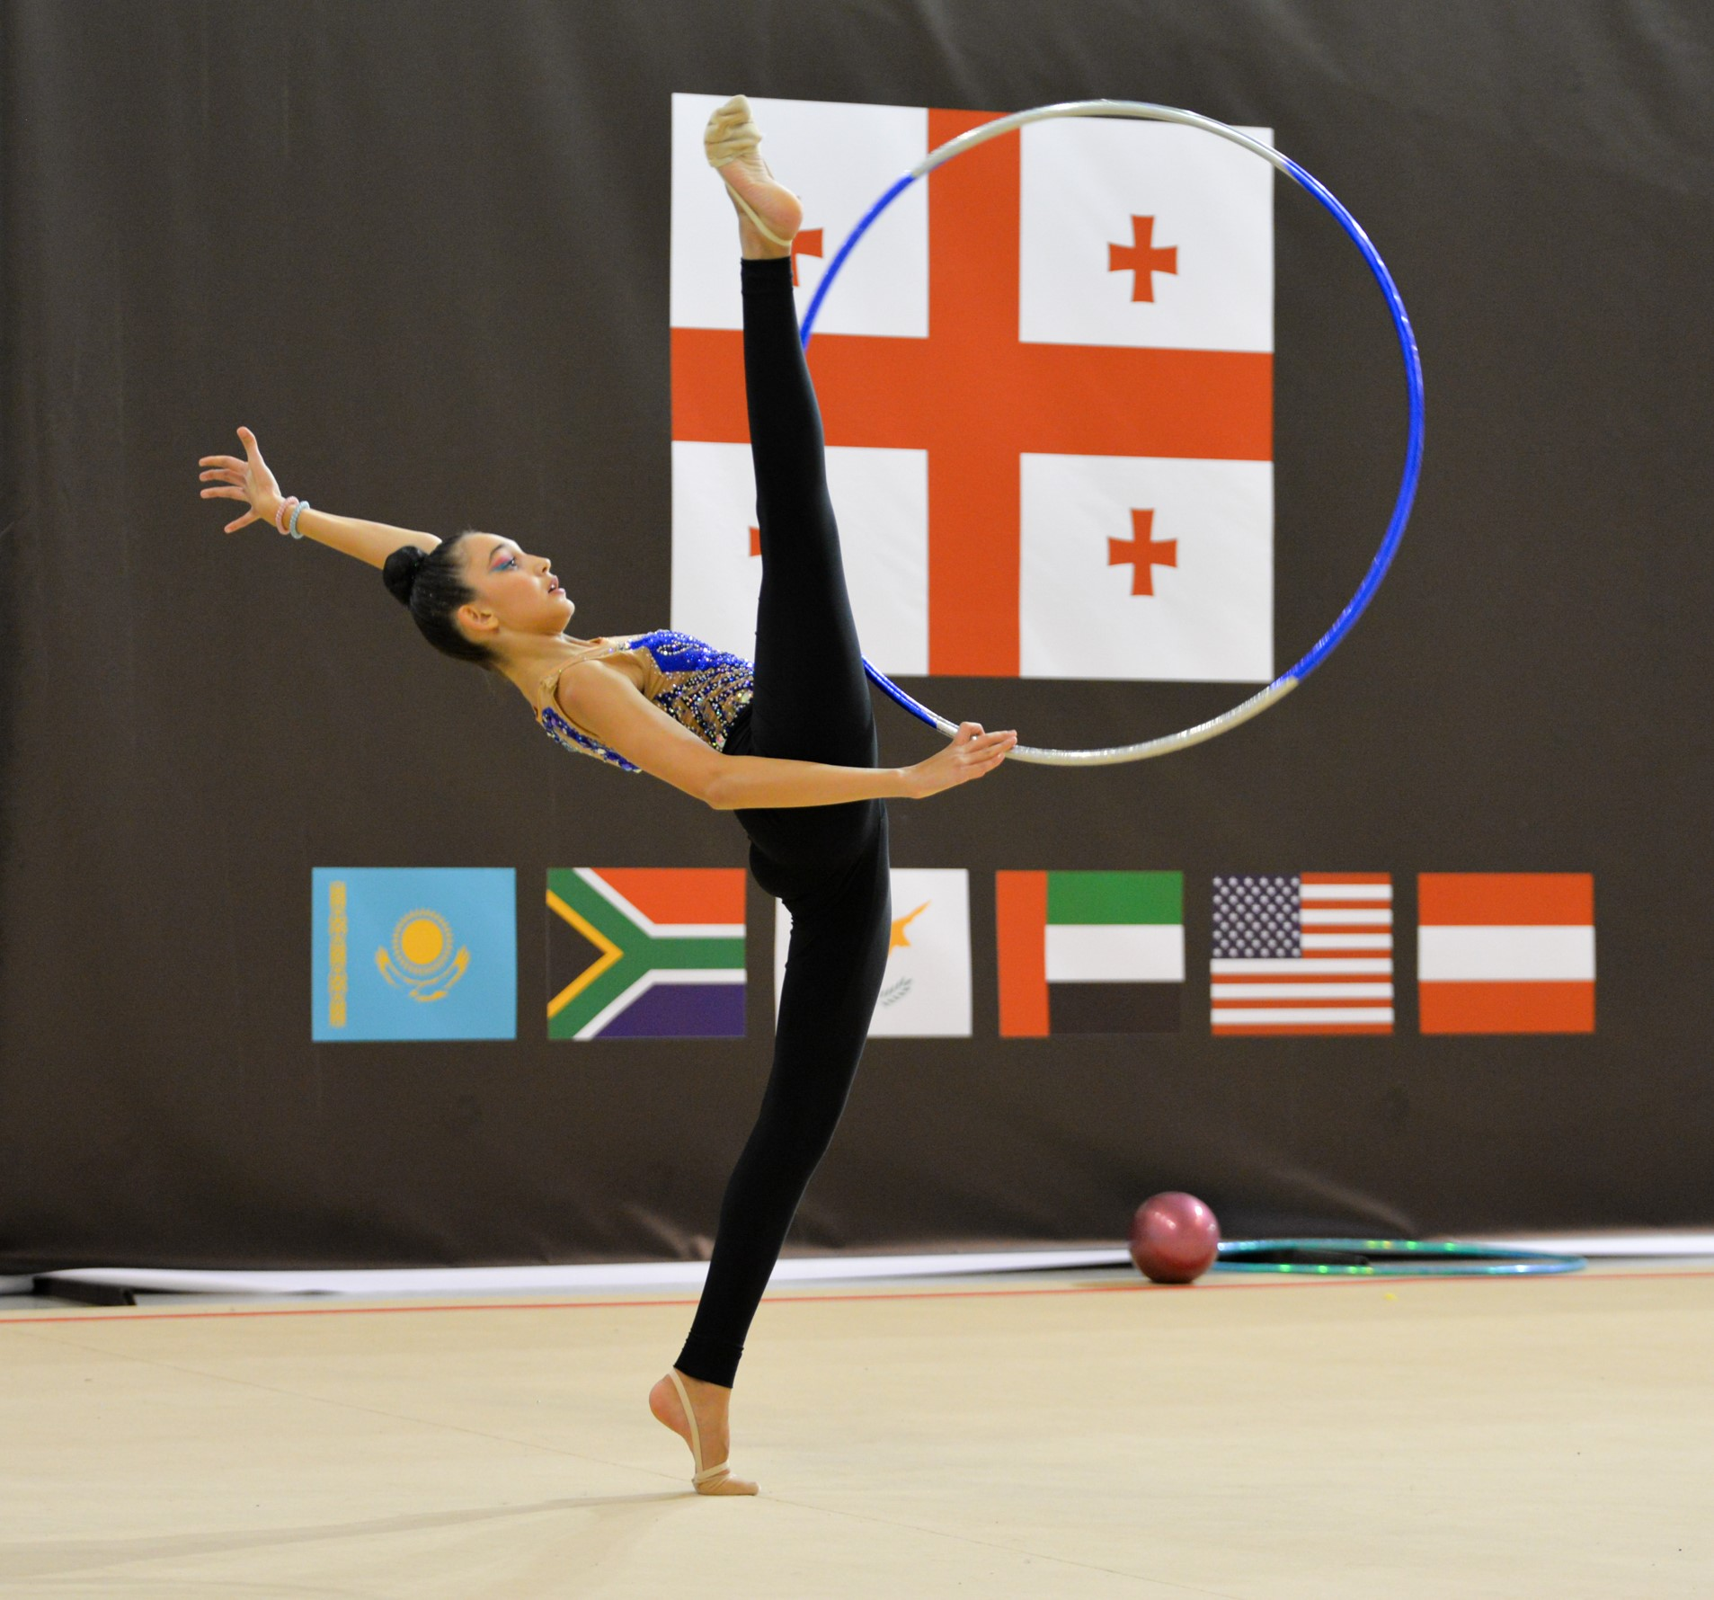

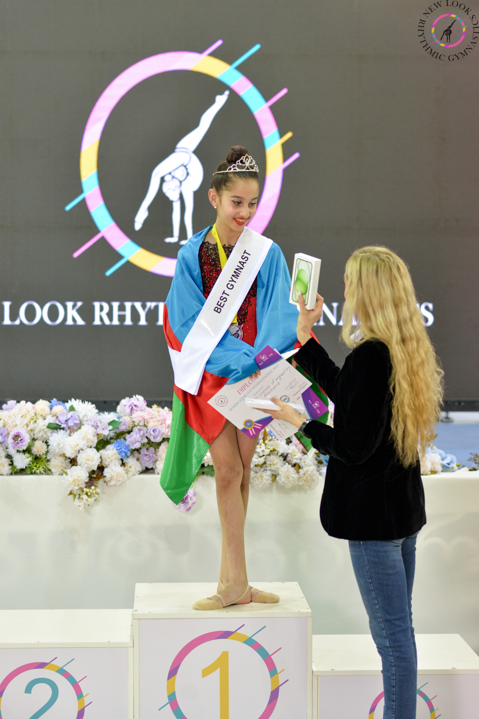
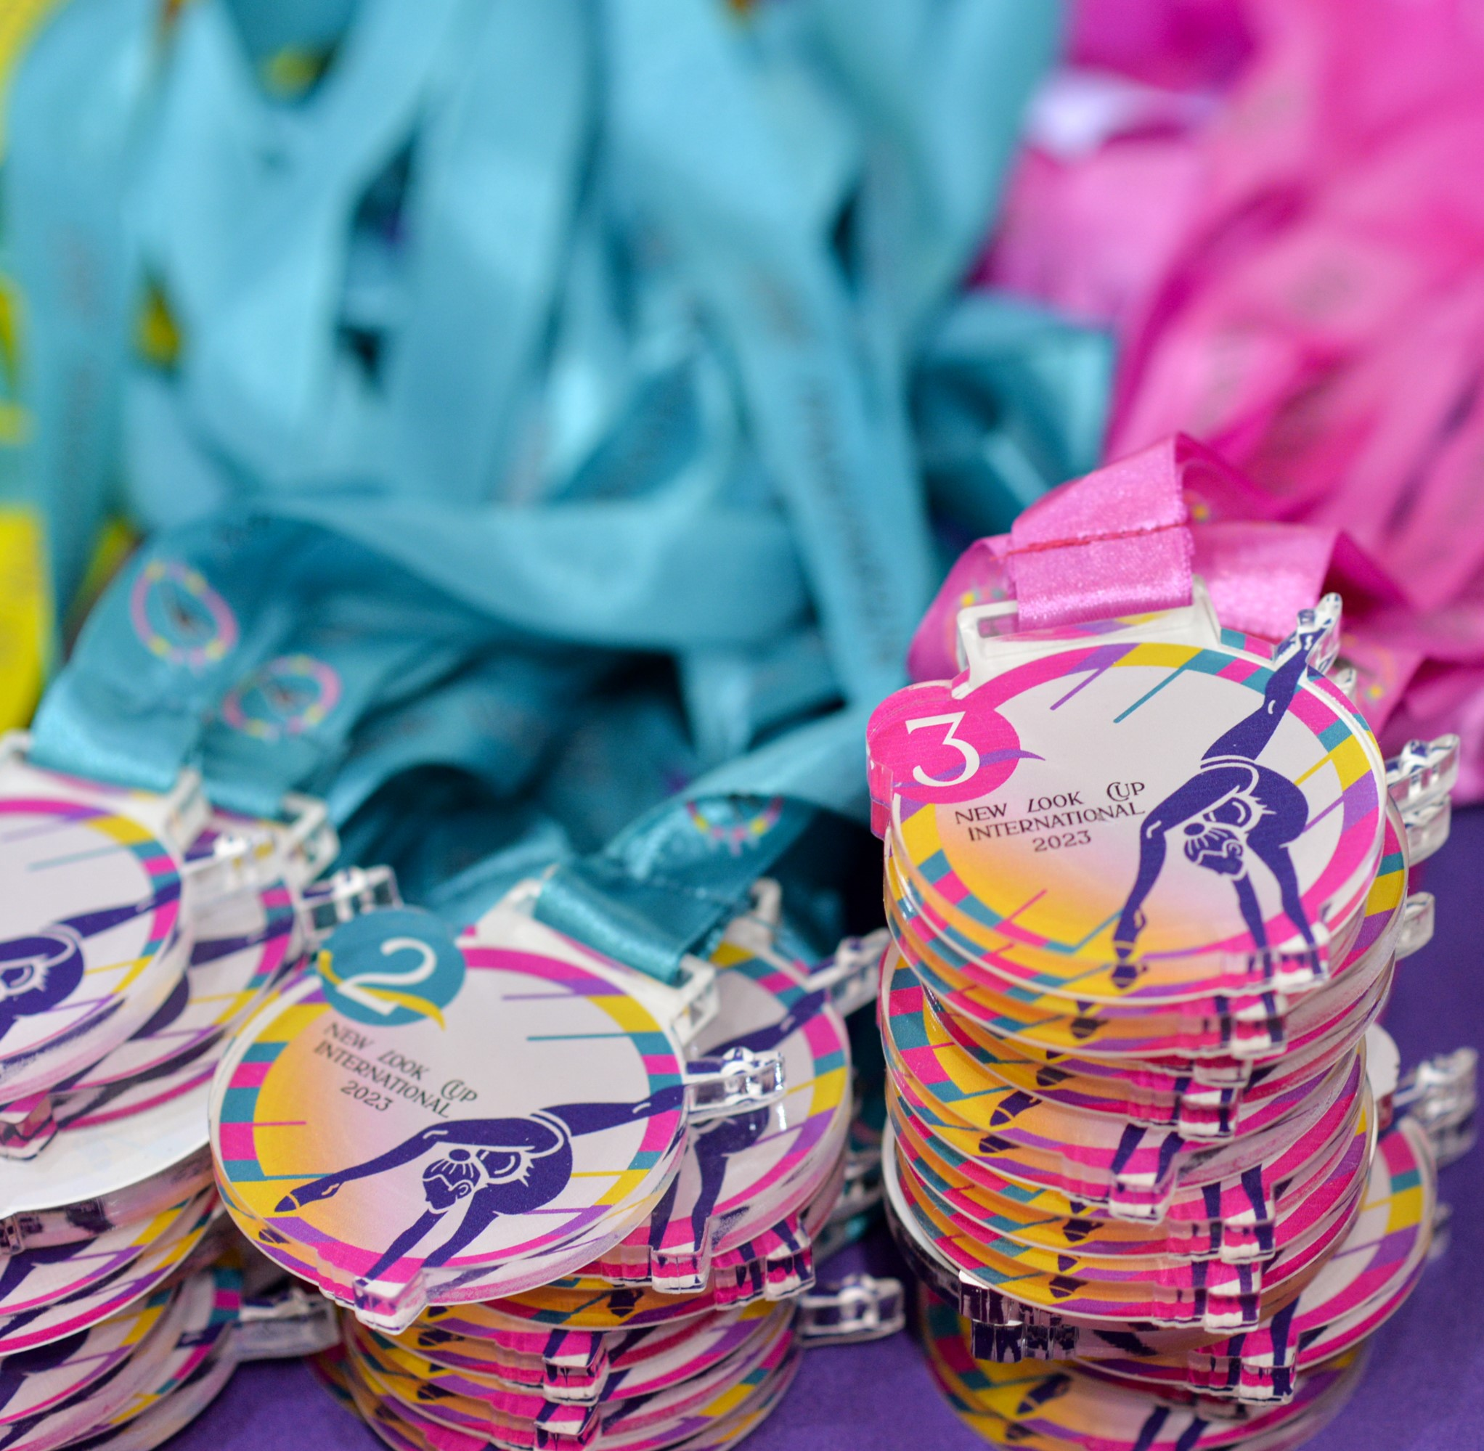
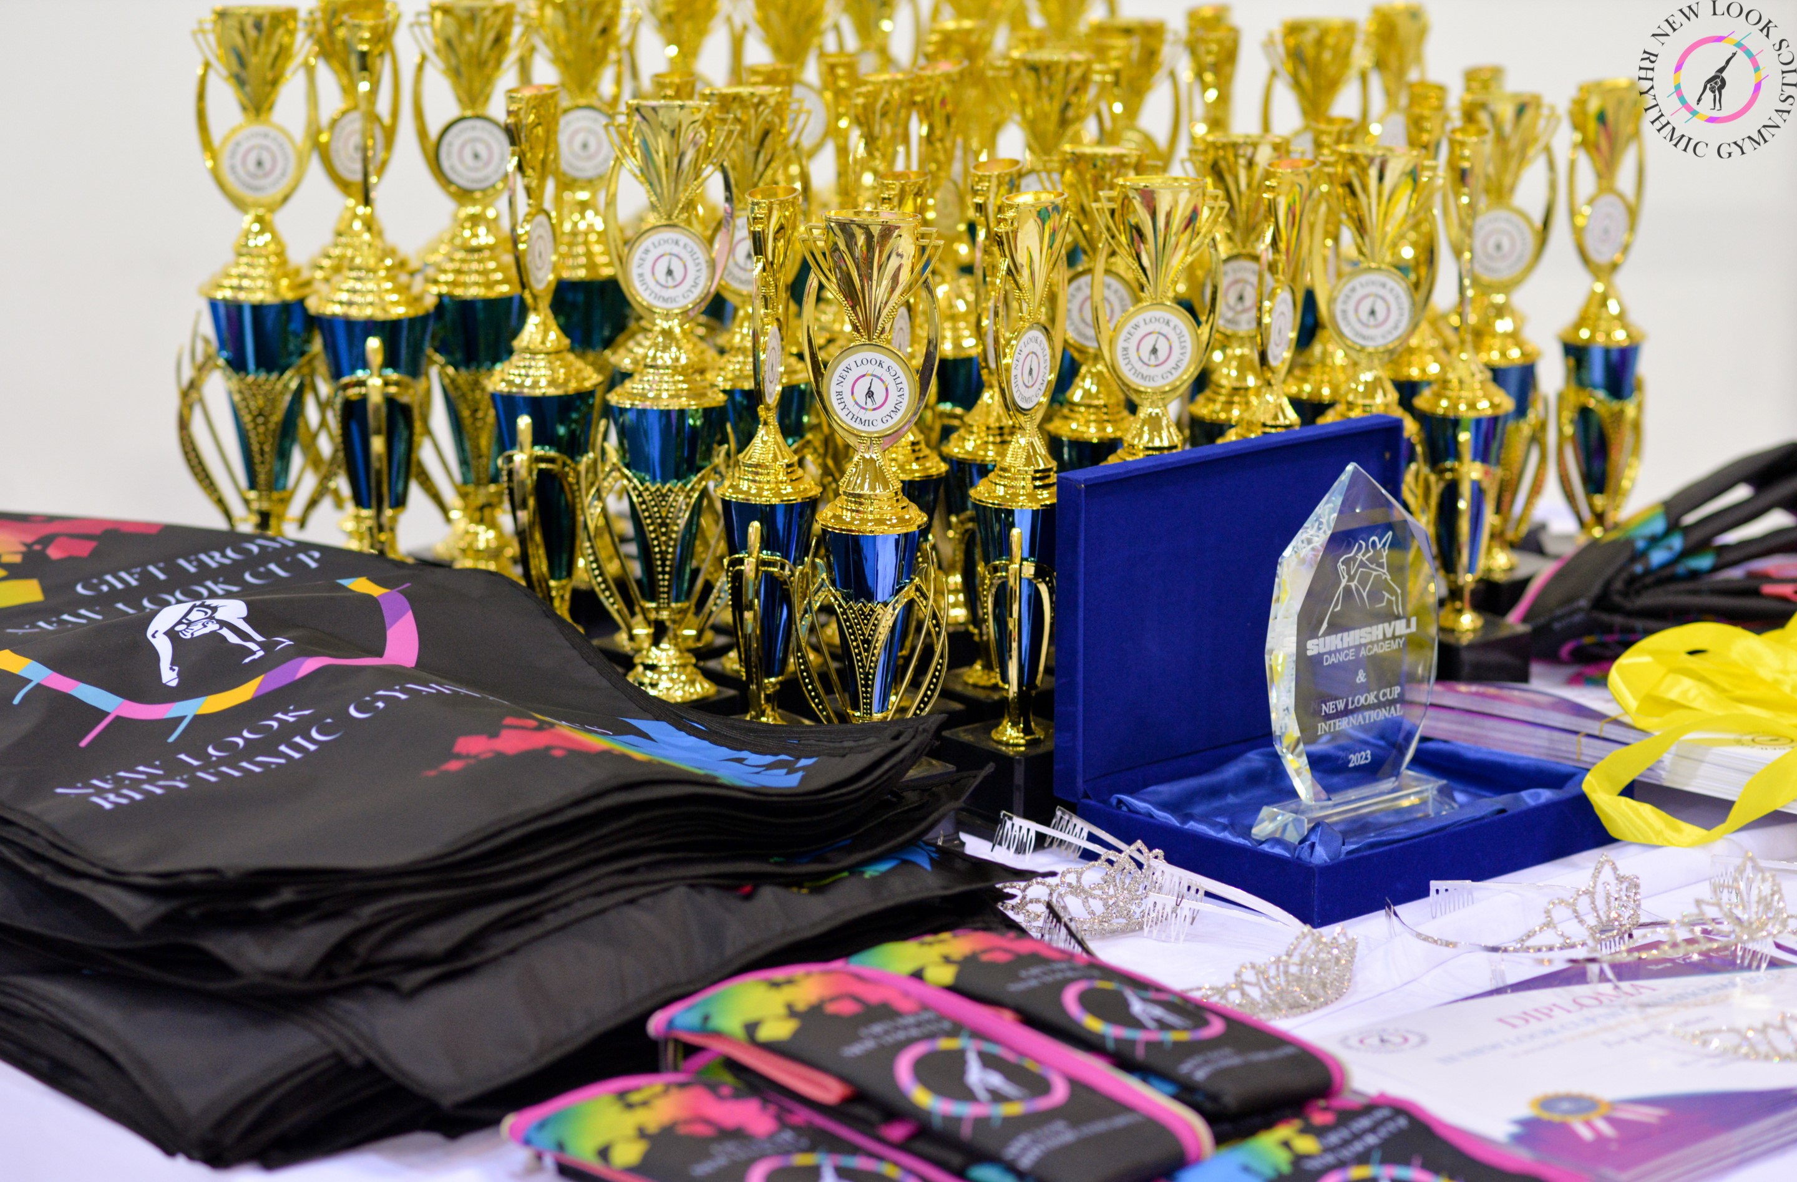
Location Dates and schedule
Competitions are held November 1-3, 2024, Tbilisi,Georgia Gymnastics Arena Digomi,2nd Lane Bob Walsh
October 30 – Arrival of teams
October 31 – Podium Trainig , 1 gymnast 30 euros) and Team Registration
18:00 Meeting of judges (After the meeting, all judges will be invited to the SPA center)
November 1-3 – 3 days of competitions and awards (November 3 - Banquet 21:00
(Gala dinner for gymnasts and parents,1 person 50 euros) registration until October 7.
The banquet for judges and coaches will be separate and will be invited)registration
until October 7
November 4- Tour from 11:00
November 5 - Departure of teams
The A category is awarded in all-around with a cup, medal and certificate. In certain events only a medal and a certificate.(The rest of the A category participants will be awarded a certificate for participation)
Categories B and C will be awarded in individual subjects and everyone will stand on a pedestal.
All participants will also be awarded original gifts.
The following nominations will also be determined
at the competition:Miss New Look Cup International 2024
Miss Grace, Miss Artistry,Miss Elegance, Miss Smile,
Miss Stretch, Trainer's Pride ,Virtuosity of performance,
Coach's hope, Miss Beautiful, Miss Dance, Miss Risk...

Slide 4
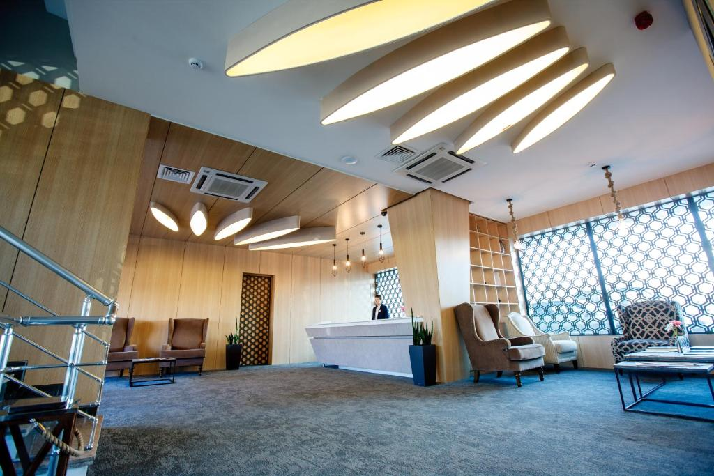
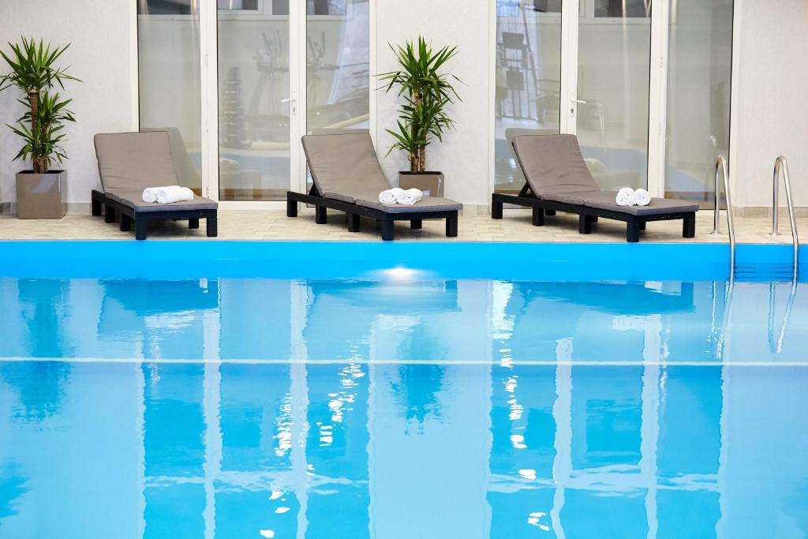
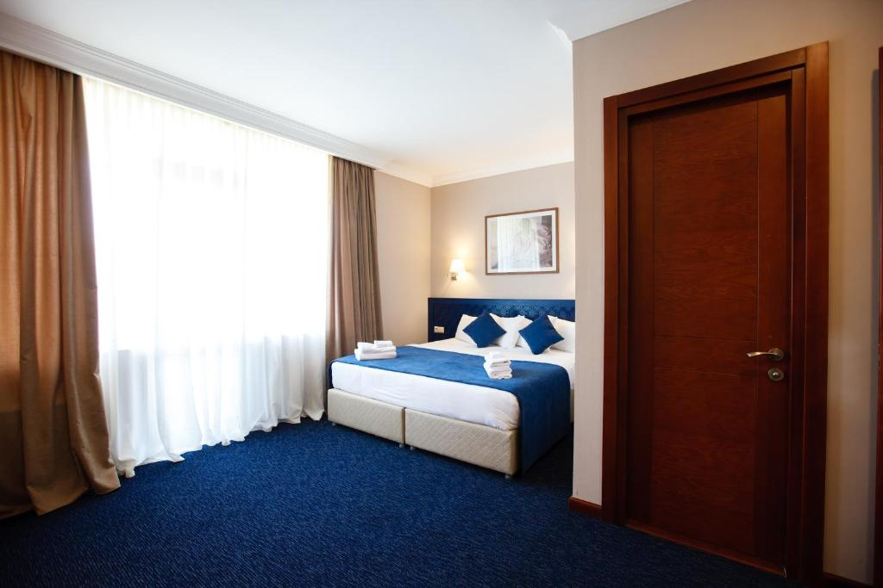
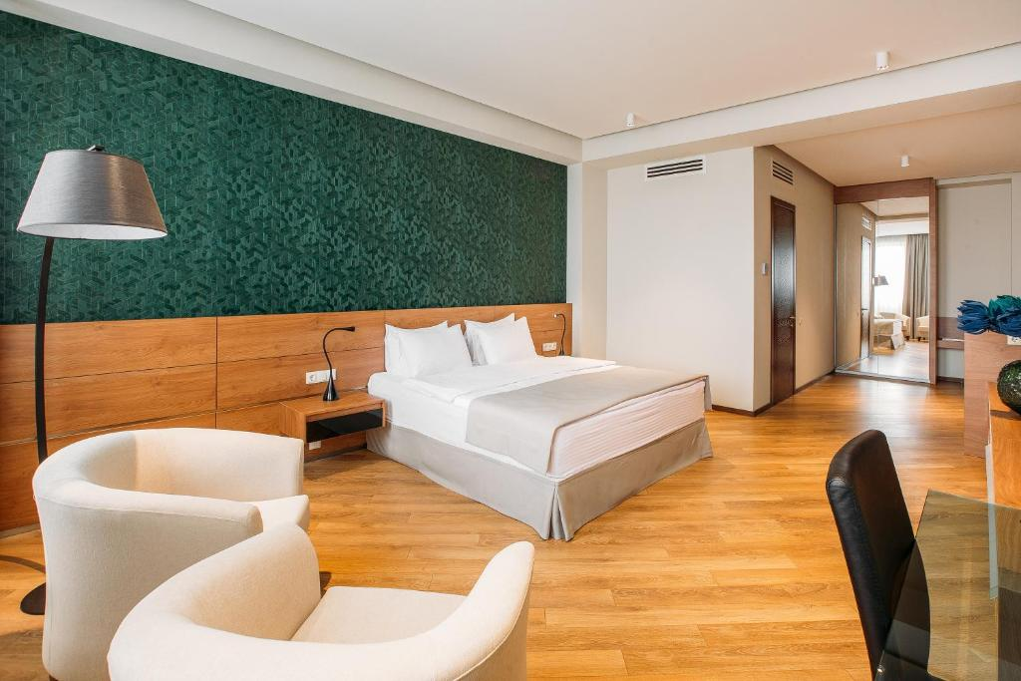
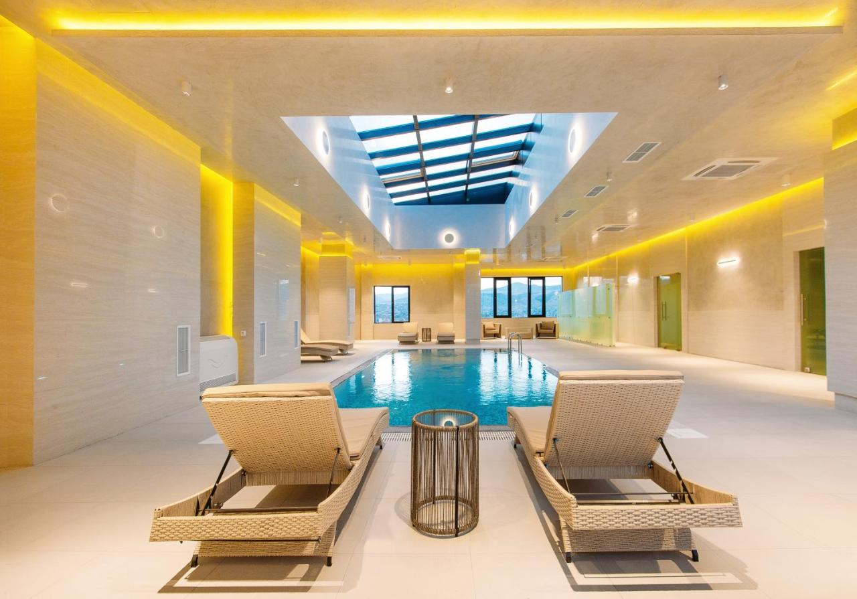
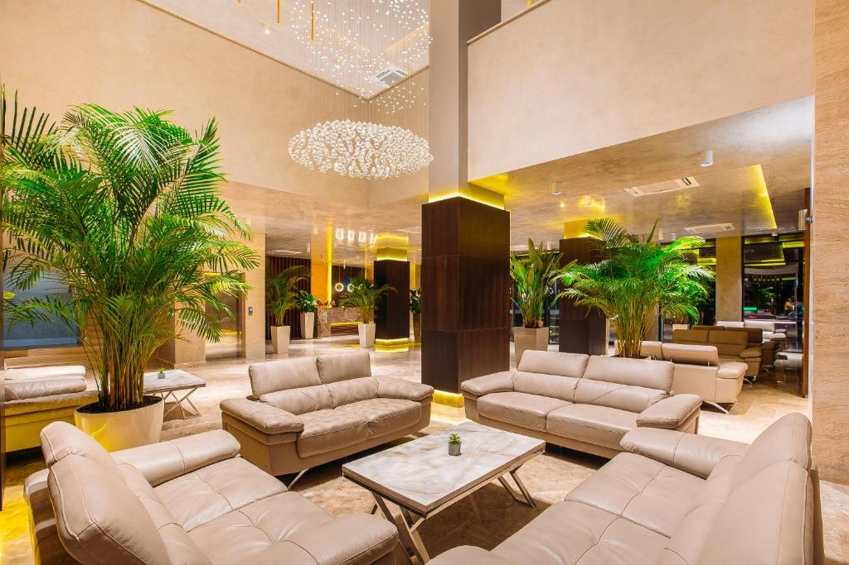
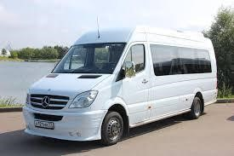
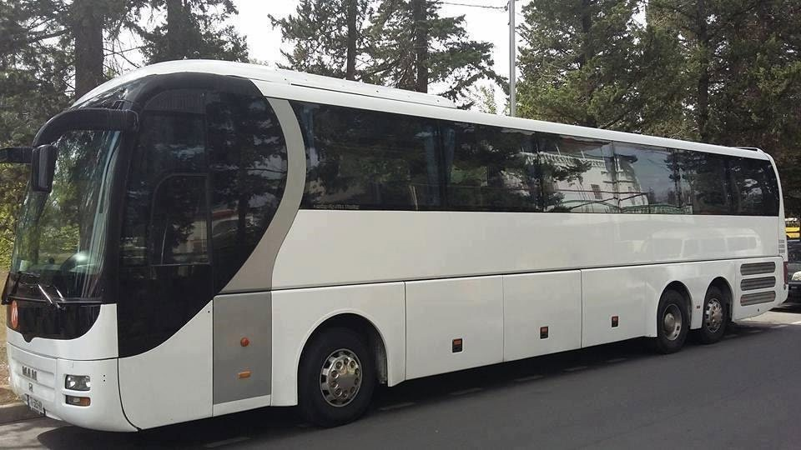
Option 1 ***
50 euros one person per night (in two/three/quadruple room
Prices include breakfast
Option 2 ****
65 euros one person per night(in two/three/quadruple room
Prices include breakfast
Please note that all rooms are limited, please write in advance and reserve when submitting applications!
Please note that everything participants and delegates must stay at the hotel Submitted agency!
Full package
Additional
plastic bag
Airport-hotel-airport + transfer (hotel-gym-hotel for all days of the competition) 50 euros per person
For competition days (Hotel-Gym-Hotel) 40 euros per person
The cost of transfer from the airport to the hotel is 20 EUR per person

Slide 5
Members of the delegation
The number of athletes is not limited. All delegations must be accompanied by 1 coach and 1 judge. The fine for missing judge– (130 euros) per judge per day
Judges must be registered through KSIS (also send application by mail)
https://rgform.eu/event.php?id_prop=5936 newlookcup@gmail.com
Registration
contribution
Entry fee: 70 euros per gymnast
180 euros team in group exercises: 6 gymnasts, 1 judge and 1 coach.
Payment of the entrance fee before October 4
Photo
Notify the organizer in advance for purchasing photographs before October 7
20 euro one music program, group 40 euro, video 20 euro.
Music
Music in MP3 format. Add via KSIS before October 20th! https://rgform.eu/event.php?id_prop=5936
The track must be signed according to the example in Latin Letters!
2012_Ninoshvili_Ana_Ball_Geo Have a USB device
Insurance
Medical security
The organizers accept no liability in the event of an accident. All participants are therefore advised to have insurance and ensure their own medical cover. The organizer will provide first aid in the hall.

Slide 6
Final registration for the site https://rgform.eu/event.php?id_prop=5936 Also send your application by email before newlookcup@gmail.com
until October 2
until October 2
DEADLINES
BRIEF
CONTENT
Accommodation form for hotel
Transfer schedule form
List of gymnasts for photos send to
The list for the banquet should be sent by
List of excursions send to
until October 7
until October 25
until October 7
until October 7
until October 7
Add music via the website https://rgform.eu/event.php?id_prop=5936
Also send by email newlookcup@gmail.com
until October 20
until October 20
Payment of the entrance fee before
Payment of 10% for stays
Penalty for absence of the Judge
until October 4
until October 4
until October 4
Entry fee and 10% hotel fee are non-refundable
Participating clubs are responsible for covering all bank fees associated with bank transfers. Please indicate the name of the country/club and the purpose of payment when transferring.

Slide 7
Category | A | B | C
2019 | W/A | W/A
2018 | W/A | W/A
2017 | W/A +1 apparatus by choice | 1 Apparatus by choice | W/A | 7 DB (Min. 1 from each group of Body Difficulty) Max 10 A and E FIG rules
2016 | W/A +1 apparatus by choice | 1 Apparatus by choice | W/A | 7 DB (Min. 1 from each group of Body Difficulty) Max 10 DA A and E FIG rules
2015 | W/A +1 apparatus by choice | 1 Apparatus by choice | W/A | 9 DB (Min. 1 from each group of Body Difficulty) Max 10 DA A and E FIG rules
2014 | 2 Apparatus by choice | 1 Apparatus by choice | W/A | 9 DB (Min. 1 from each group of Body Difficulty) Max 15 DA A and E FIG rules
2013 | 2 Apparatus by choice | 1 Apparatus by choice | W/A | 9 DB (Min. 1 from each group of Body Difficulty) Max 15 DA A and E FIG rules
2012 | 2 Apparatus by choice | 1 Apparatus by choice | W/A | 9 DB (Min. 1 from each group of Body Difficulty) Max 15 DA A and E FIG rules
2011 | 3 Apparatus by choice | 2 Apparatus by choice | 1 Apparatus by choice | According to FIG Juniors COP
2009-2010 | 3 Apparatus by choice | 2 Apparatus by choice | 1 Apparatus by choice | According to FIG Juniors COP
2008 and older | 4 Apparatus | 2 Apparatus by choice | 1 Apparatus by choice | According to FIG Seniors COP
Gymnasts in B/P exercises must have all three difficulty groups, max three dance of 8 seconds, may include a series of 3 pre-acrobatic elements in the exercise (the same or different, but not repeated in other series, maximum 2 series.
Chief international judge Eliso Bedoshvili

Slide 8
Group Program
2017 | W/A
2016 | W/A
2015 | W/A
2014 | W/A
2013 | W/A
2012 | 1 App. by choosing (5 Hoop or 5 Balls)
2011 | 1 App. by choosing (5 Hoop or 5 Clubs)
2010-2009 | (5 Hoop / 5 Clubs)
2008 | 5 Hoop / 3 Ribbons + 2 Balls
Payment and Banking Requisites
Payment is made using bank details or money transfer in the name of DZAGOEVA MADONA All transfers are in euro.
don't send SHARE method
Bank details For participation entry fee:
BENEFICIARY'S BANK: Bank of Georgia , SWIFT: BAGAGE22
Adress: Gagarina 29a Tbilisi 0160, Georgia
BEN'S Account: GE83BG0000000821761200
NAME OF BENEFICIARY: MADONA DZAGOEVA
Bank details for hotel payments:
BENEFICIARY'S BANK: JSC TBC Bank ,SWIFT: TBCBGE22
Adress: K. Marjanishvili St. 7, Tbilis
BEN'S Account: GE65 TB70 1834 5064 3000 89
NAME OF BENEFICIARY: MADONA DZAGOEVA

Slide 9
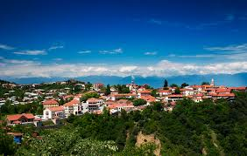


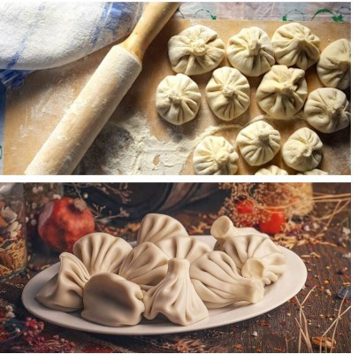

Special tour from the organizers
1-day tour in Kakheti - Sighnaghi Bodbe
Wine tour of Kakheti (for adults).
(including transport, guide, lunch) 45 euros per person
1-day tour to Kazbegi (Gergeti Church, Gudauri, Ananuri) With Khinkali Master Class (from potatoes
and pork) optional.
(including transport, guide, lunch) 55 euros per person
Contact information of the organizing committee
WhatsApp/Telegram: +995571247171 Madonna Dzagoeva (Russ) (English send to mail:
dzagoevamadonna@gmail.com newlookcup@gmail.com
Instagram/Facebook: new_look_rhythmic gymnastics
Live broadcast via YouTube, channel Madonna Dzagoeva

